Slide 1

Web API Security
(API Version 2.0)
A Complete Understanding
By Muthuraja Learn @ Lunch Time

Slide 2
OUTLINE
What is Security & Why we need?
Best Practices for API Security Awareness
Web API 2.0 Architectural Design
Types of Authentication
Authentication & Authorization
Web API Hosting Layers
Security in Web API Version 1
New Pipeline in Web API 2.0
OWIN Middleware
Ways to pass credential
Web API Handlers & Filters
Accessing Client Identity
LAB: Building Web API from scratch with Security
By Muthuraja Learn @ Lunch Time

Slide 3
Introduction
What is SECURITY?
Security is a vast field with many different meanings and definitions. Most commonly when talking about Web API security, we mean authentication and possibly encryption that all require different expertise and approaches when it comes to testing and quality:
Authentication : reliably identify end user
Authorization : give identified user access to correct resources/data
Encryption : hide information from unauthorized access
Signatures : ensure information integrity
Why we need to implement SECURITY?
To prevent vulnerabilities, attacks and damages to consumers or providers. The area of security vulnerabilities is a diverse field. There are many different attacks with different methods and targets. One way to categorize vulnerabilities is by target area:
Network / OS / Driver: issues in the operating system and network components (e.g. buffer overruns, flooding with sockets, DOS attacks)
Application layer: issues in the hosting application server and related services (e.g. message parsing, session hijacking or security misconfigurations)
API / component: functional issues in the actual API (e.g. injection attacks, sensitive data exposure, incomplete access control)
By Muthuraja Learn @ Lunch Time

Slide 4
Web API Security Awareness
Best Practices for API Security Awareness
Compared to functionality and performance, security may get little attention in QA. Often the frameworks and components used are trusted to be “secure” and warrant no further assessment in this regard. A serious approach to security testing should include (but not necessarily be limited to):
Requirements: Make security visible in requirements and backlog processes, on the samel level as performance, functionality, usability, et c.
Knowledge: Invest in security know-how and testing among your developers and testers, so they understand common security breaches and how to guard against them.
Prevention: Test and assess security early in your project and don’t leave it to some single individual at the end right before production.
Monitoring: Continuously monitor your applications for security vulnerabilities using available tools or homegrown solutions – as you would performance and functionality, with focus how new components or changes can have unwanted side effects.
Awareness: Make use of free tools and resources (like those available at OWASP) to get an overview of relevant vulnerabilities and how to make sure they do not affect you.
By Muthuraja Learn @ Lunch Time

Slide 5
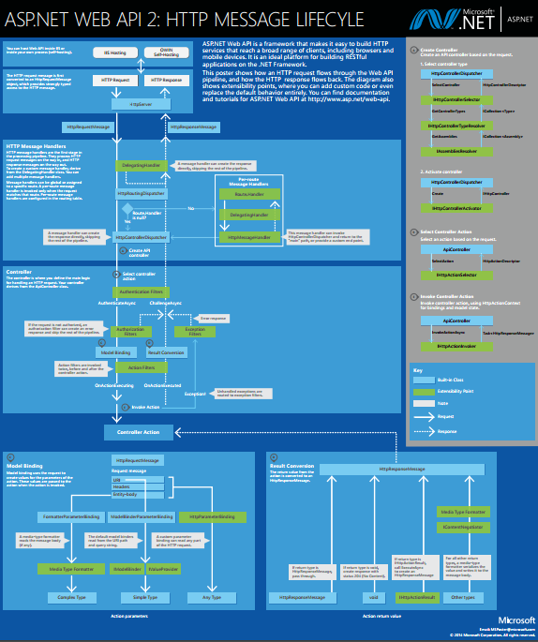
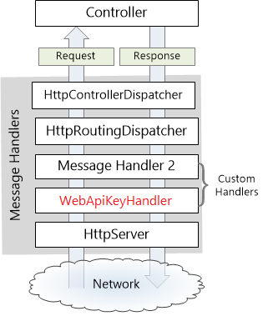
ASP.NET Web API 2.0 Http Message Lifecycle
Here you go
http://www.asp.net/media/4071077/aspnet-web-api-poster.pdf
By Muthuraja Learn @ Lunch Time

Slide 6
Web API 2.0 Authentication Types
No Authentication
For applications that don’t require any user authentication. If you select No Authentication, the application will contain no web pages for logging in, no UI indicating who is logged in, no entity classes for a membership database, and no connection string for a membership database.
Individual Authentication
For applications that store user profiles in a SQL Server database. If you select Individual User Accounts, the sample application will be configured to use ASP.NET Identity (formerly known as ASP.NET membership) for user authentication. ASP.NET Identity enables a user to register an account, by creating a username and password on the site or by signing in with social providers such as Facebook, Google, Microsoft Account, or Twitter.
Organizational Authentication
For applications that authenticate users with Active Directory, Windows Azure Active Directory, or Office 365. If you select Organizational Accounts, the sample application will be configured to use Windows Identity Foundation (WIF) for authentication based on user accounts in Azure Active Directory (Azure AD, which includes Office 365) or Windows Server Active Directory.
Windows Authentication
For applications (intranet) that wants basic/form windows authentication. This is a classic authentication. If you select Windows Authentication, the sample application will be configured to use the Windows Authentication IIS module for authentication.
By Muthuraja Learn @ Lunch Time

Slide 7
Authentication & Authorization
Authentication
It is the verification of the credentials of the connection attempt. This process consists of sending the credentials from the remote access client to the remote access server in an either plaintext or encrypted form by using an authentication protocol.
Authorization
This refers to rules that determine who is allowed to do what. Authorization occurs after successful authentication.
By Muthuraja Learn @ Lunch Time

Slide 8
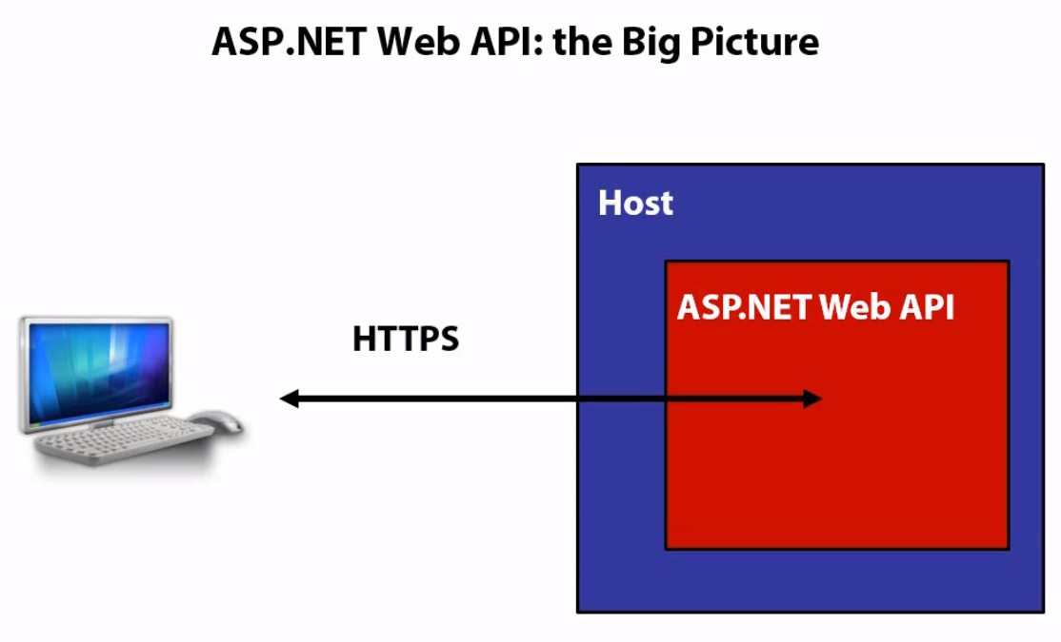
Web API Hosting
By Muthuraja Learn @ Lunch Time

Slide 9
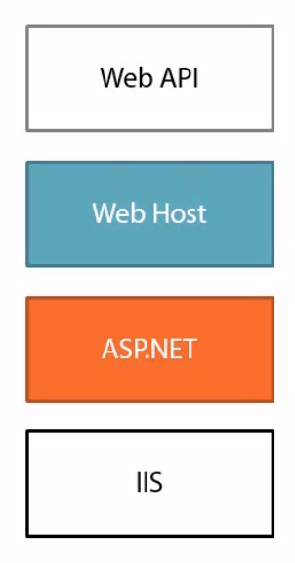
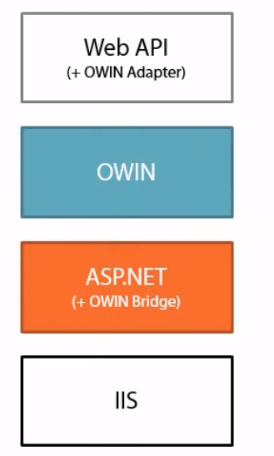
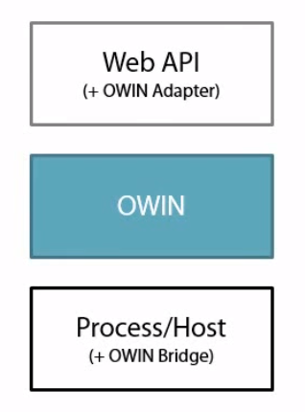
Web API Hosting
Classic Hosting
OWIN Hosting on IIS
Pure OWIN Hosting
By Muthuraja Learn @ Lunch Time

Slide 10
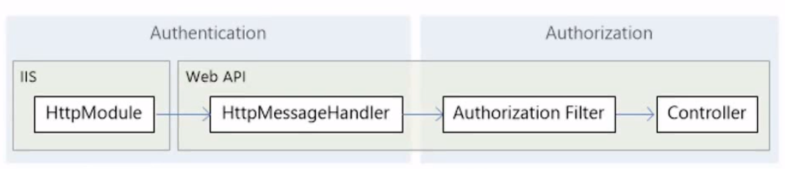
Security in Web API 1.0
By Muthuraja Learn @ Lunch Time

Slide 11
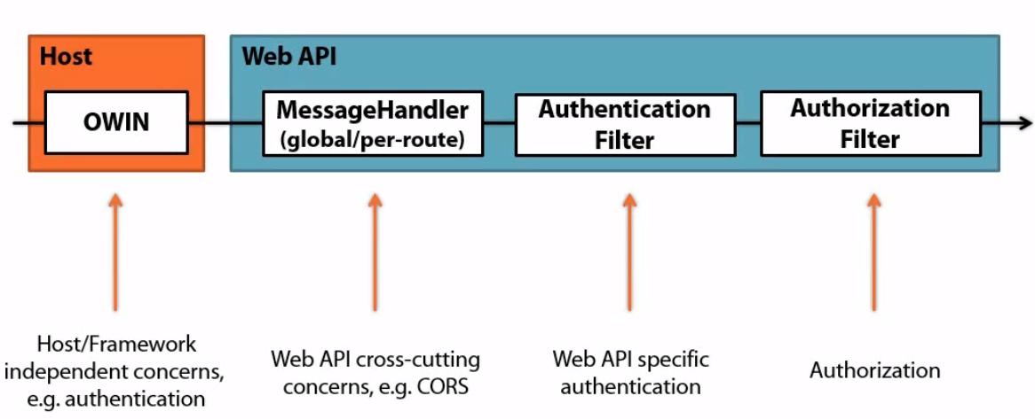
Security in Web API 2.0
New Pipeline in Web API 2.0
By Muthuraja Learn @ Lunch Time

Slide 12
OWIN Middleware
OWIN (Open Web Interface for .NET)
OWIN allows web apps to be decoupled from web servers. It defines a standard way for middleware to be used in a pipeline to handle requests and associated responses. ASP.NET Core applications and middleware can interoperate with OWIN-based applications, servers, and middleware.
In other words, OWIN defines a standard interface between .NET web servers and web applications. The goal of the OWIN interface is to decouple server and application, encourage the development of simple modules for .NET web development, and, by being an open standard, stimulate the open source ecosystem of .NET web development tools
Example:-
Katana – OWIN implementations for Microsoft Servers and Frameworks. Katana is a flexible set of components for building and hosting OWIN-based web applications.
Web site to learn more about Katana is http://katanaproject.codeplex.com/. This site is the home for Katana host, server, and middleware source code and documentation
By Muthuraja Learn @ Lunch Time

Slide 13
Passing Credential
Ways to pass credentials to Web API
Header
Authentication: <schema> <token>
Ex: authentication: basic 8skls02003kemdm2-4l23ll2-9
Query String
? <key-value pair>
Ex: ?user=84k42d&pwd=ll340kj2
Client Certificate
Creating and adding CC on client machine
Read CC (X509Certificate2) thru Request.GetClientCertificate method
Cookies
Creating and sending cookie to client machine thru Response.Headers.AddCookies
Read Cookie thru Request.Headers.GetCookies method
By Muthuraja Learn @ Lunch Time

Slide 14
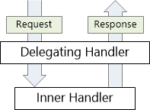
Web API Handlers and Filters
Message Handler
A message handler is a class that receives an HTTP request and returns an HTTP response. Message handlers derive from the abstract HttpMessageHandler class.
Typically, a series of message handlers are chained together. The first handler receives an HTTP request, does some processing, and gives the request to the next handler. At some point, the response is created and goes back up the chain. This pattern is called a delegating handler.
By Muthuraja Learn @ Lunch Time

Slide 15
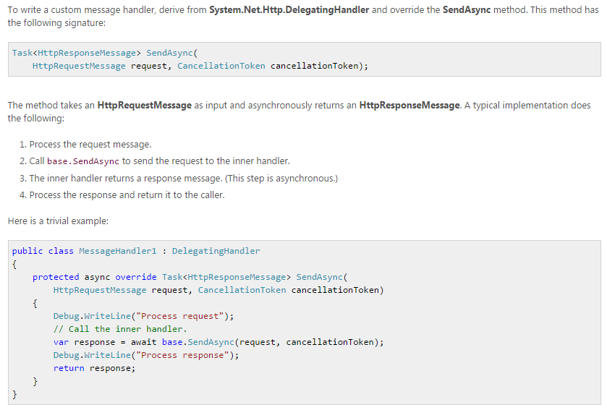
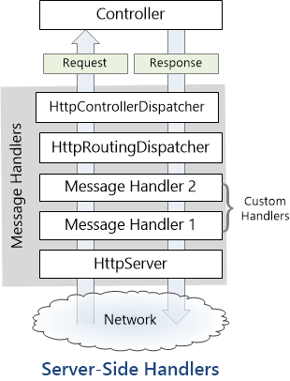
Web API Handlers and Filters
Custom Message Handler
By Muthuraja Learn @ Lunch Time

Slide 16
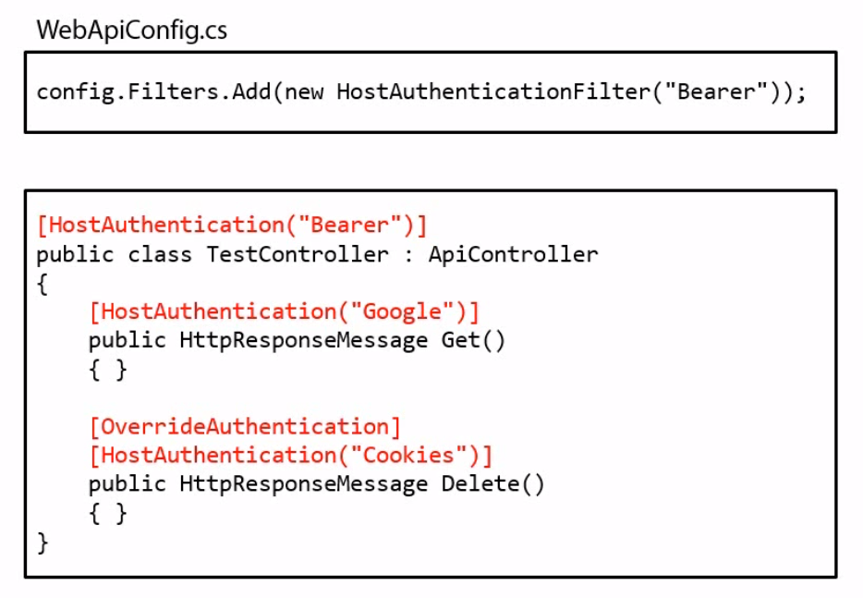
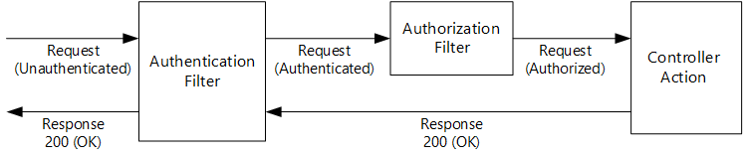
Web API Handlers and Filters
Authentication Filter
An authentication filter (IAuthenticationFilter) is a component that authenticates an HTTP request. Web API 2 and MVC 5 both support authentication filters, but they differ slightly, mostly in the naming conventions for the filter interface. Authentication filters let you set an authentication scheme for individual controllers or actions. That way, your app can support different authentication mechanisms for different HTTP resources.
The IAuthenticationFilter interface has two methods:
AuthenticateAsync authenticates the request by validating credentials in the request, if present.
ChallengeAsync adds an authentication challenge to the HTTP response, if needed.
By Muthuraja Learn @ Lunch Time

Slide 17
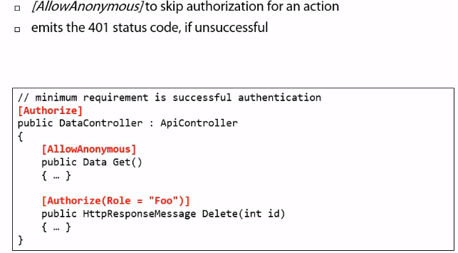
Web API Handlers and Filters
Authorization Filter
Authorization is to perform authorization logic based on current user and the user’s role. It is all depend on the type of Authentication set up on Web API. For custom authorization filter, we can create a class that extends/inherits from AuthorizeAttribute.
By Muthuraja Learn @ Lunch Time

Slide 18
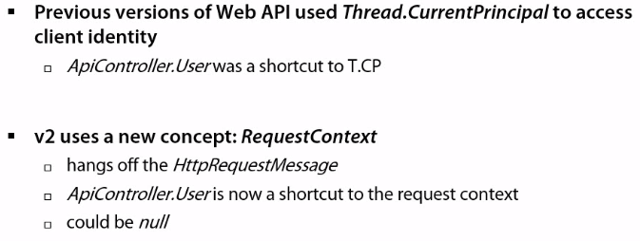
Web API Handlers and Filters
By Muthuraja Learn @ Lunch Time

Slide 19
Sample Web API (Security Pipeline )
Building Security Pipeline
Build Web API from Scratch
Implement OWIN Middleware
Implement Security (Handlers & Filters)
Implementing Action Filters
LAB 1
By Muthuraja Learn @ Lunch Time

Slide 20
Any question ?
By Muthuraja Learn @ Lunch Time

Slide 21
Thank You
By Muthuraja Learn @ Lunch Time

